Slide 1
Lecture 22 – Designing Classes and Constructors
Classes, and constructor
Kok-Seng Wong | 2021

Slide 2


Motivation example
[source]

Slide 3
Learning outcomes
Upon the completion of this lecture, students will be able to:
understand the class definition and instantiation concept in object-oriented programming.
create instances of an object in Python.
understand and explain built-in class attributes in Python.

Slide 4
Class definition
Creating a new class creates a new type of object, allowing new instances of that type to be made.
class <class-name>():
"""class specification"""
<method definitions>

Slide 5
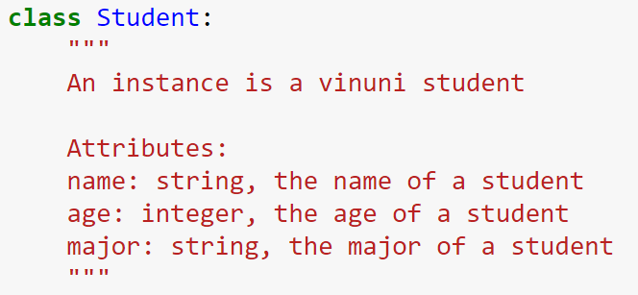
Class definition: specification
Creates a new class called Student
keyword
Brief summary
Description
Attributes list
Attribute’s name

Slide 6
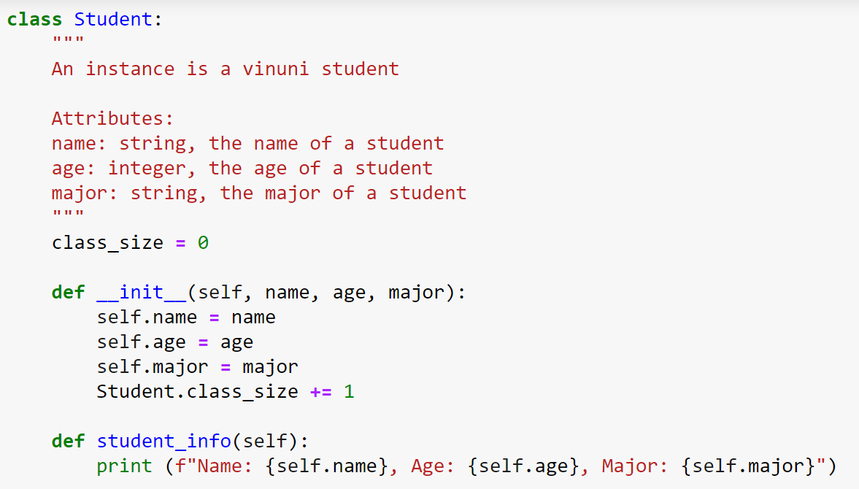
Class definition: method
class variable (class attribute): can be accessed from inside or outside the class
Class constructor (also known as initialization method)
Instance method

Slide 7
constructors
A constructor is a special type of method (function) which is used to initialize (assign values) the instance members of the class when an object of class is created.
In Python the __init__ method is called the constructor and is always called when an object is created.
An object cannot be created if we don’t have a constructor in our program.

Slide 8
Types of constructors
Default constructor: constructor that has only self as an argument
Parameterized constructor: has multiple parameters along with the self
def __init__(self):
# body of the constructor
def __init__(self, name, age):
# body of the constructor

Slide 9
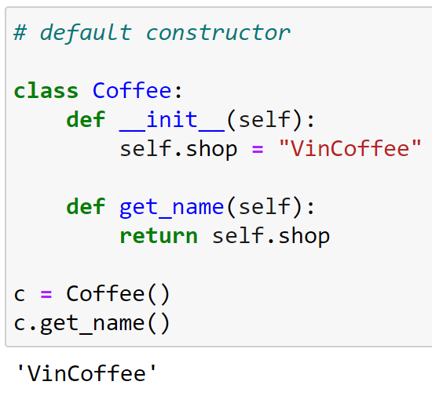
Default constructor
Constructor
Instance method

Slide 10
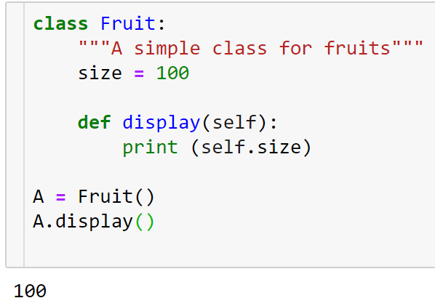
Default constructor
Implicitly created by Python during program compilation if we do not declare a constructor in our program.
Constructor was not declared
Default constructor initializes the objects without performing any task!
Instance method

Slide 11
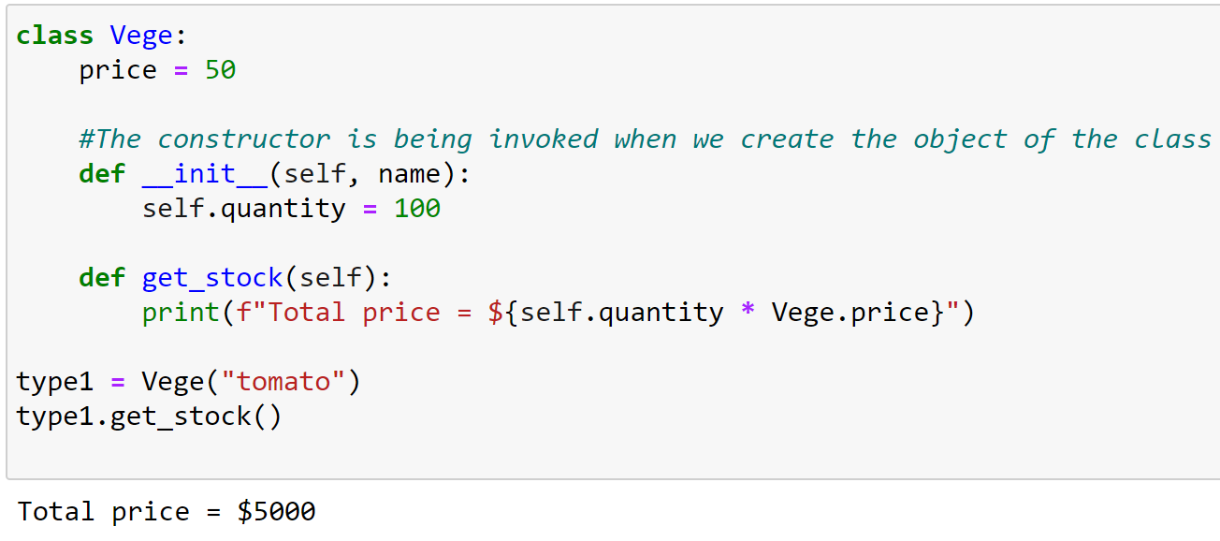
Parameterized constructor (1/2)
Parameterized constructor
Instance method
Accessing class attribute

Slide 12
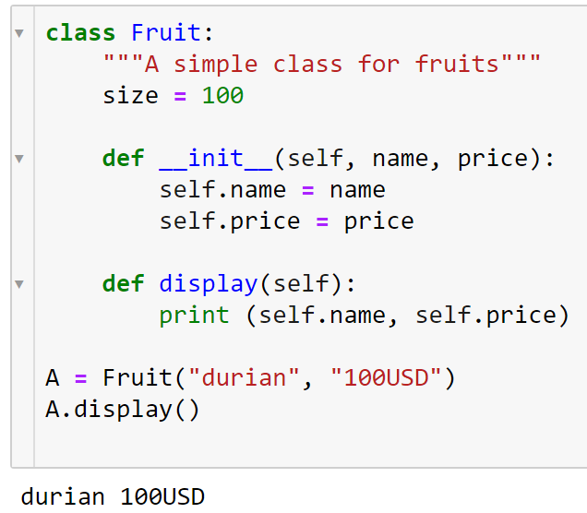
Parameterized constructor (2/2)
Parameterized constructor
Instance method

Slide 13
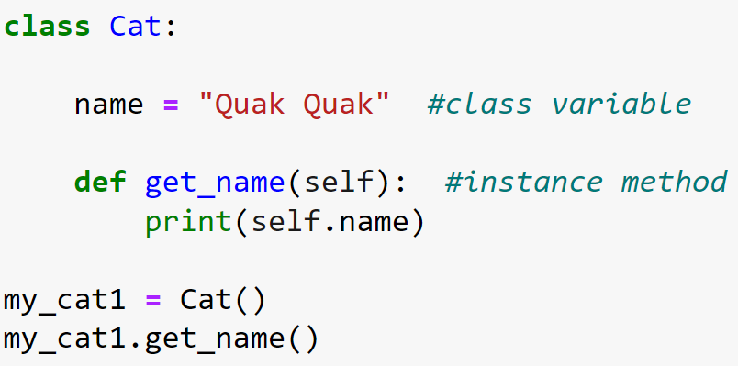
Class practice

Slide 14
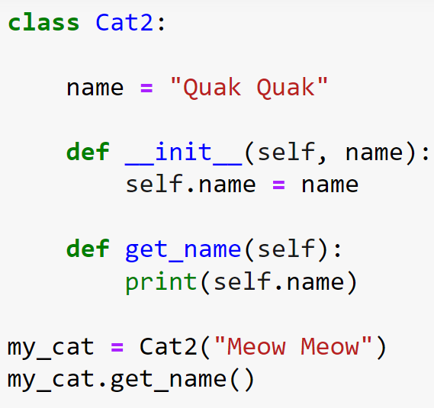
Class practice

Slide 15
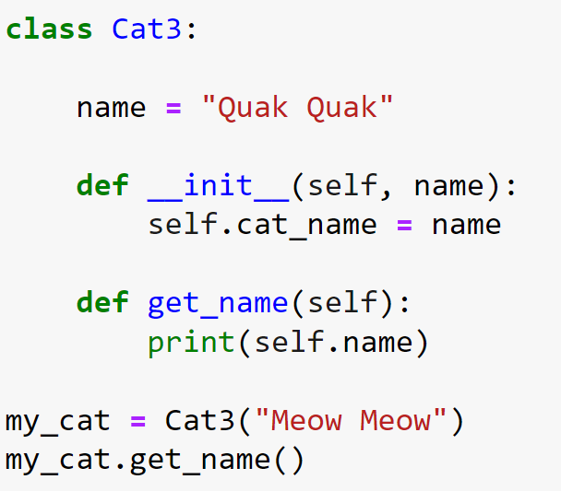
Class practice

Slide 16
__init__ method
__init__
It is used for the initialization of the data members.
Automatically invoked when the object of the class is created.
Every class has __init__ and this is executed when we instantiate the class.
self
used as the reference to the object of the class.

Slide 17
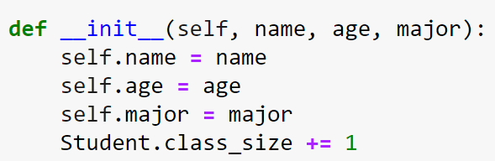
Instance attributes
always the first argument for any method defined in a class.
In the body of __init__, there are three statements using the self variable.
When instantiate a Student object, Python creates a new instance and passes it to the first parameter of __init__
instance attribute: value is specific to a particular instance of the class

Slide 18
Instantiating an object
>>> class Student:
... Pass
Object’s Memory Address
Instantiating a student object
>>> Student()
<__main__.Student object at 0x000001C2B5F580A0>
>>> Ali = Student()
>>> Baba = Student()
>>> Ali == Baba
False

Slide 19
Creating instance objects (1/2)
To create instances of a class, we call the class using class name and pass in whatever arguments.
When instantiate an object, Python creates a new instance and passes it to the first parameter of __init__. This step will remove the self parameter and hence, we only care about other parameters.
By using the self keyword, we can access the attributes and methods of the class.

Slide 20
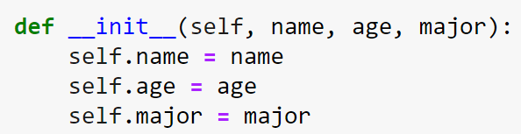
Creating instance objects (2/2)
To create objects of Student class:
Parameterized constructor
No | Name | Age | Major
1 | Michelle | 20 | Computer Science
2 | Mark | 22 | Engineering
3 | Tu | 19 | Finance
Passing arguments to the name, age, and major
std1 = Student("Michelle", 20, "Computer Science")
std2 = Student("Mark", 22, "Engineering")
std3 = Student("Tu", 19, "Finance")

Slide 21
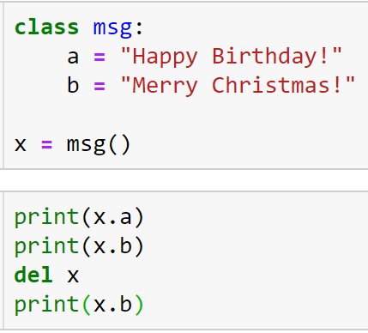
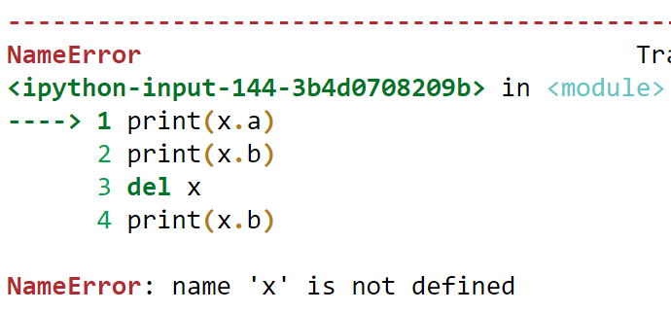
Deleting an object
del<object-name>

Slide 22
Python classes methods
Instance method
std1.student_info()
std2.student_info()
std3.student_info()
print(f"The total number of students is {Student.class_size}")
Access the object's attributes using the dot operator with object

Slide 23
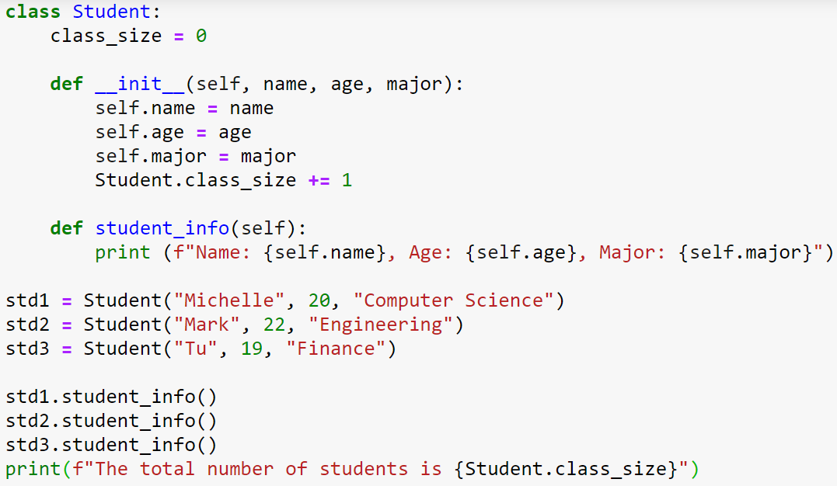
Python classes methods

Slide 24
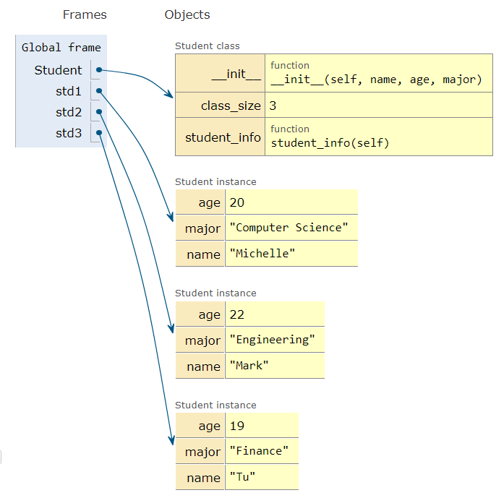

Slide 25
Converting an object to a string
__str__: It is used to return a string representation as defined by the class creator.
class School: def __init__(self, name): self.name = name def __str__(self): return f"Welcome to {self.name}"
s1 = School("VinUniversity") print(s1)
class School: def __init__(self, name): self.name = name
s1 = School("VinUniversity") print(s1)
<__main__.School object at 0x000001AA755AA460>
Welcome to VinUniversity

Slide 26

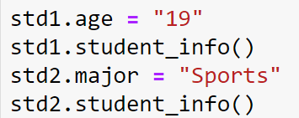

Modifying attributes of classes and objects
std1
std2

Slide 27
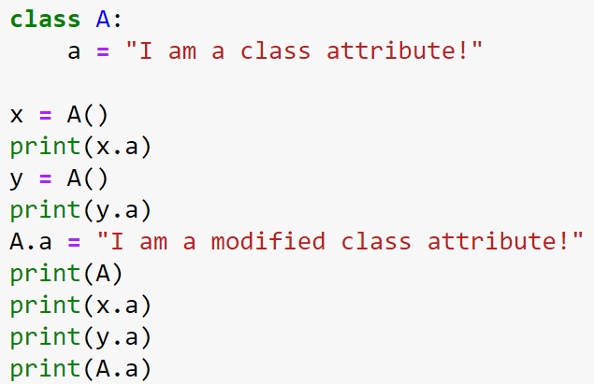
Class practice

Slide 28
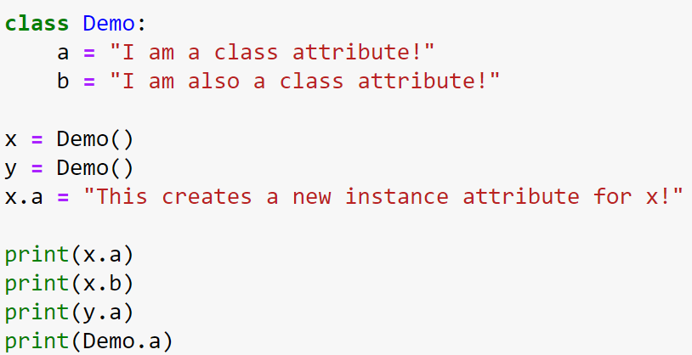
Class practice

Slide 29
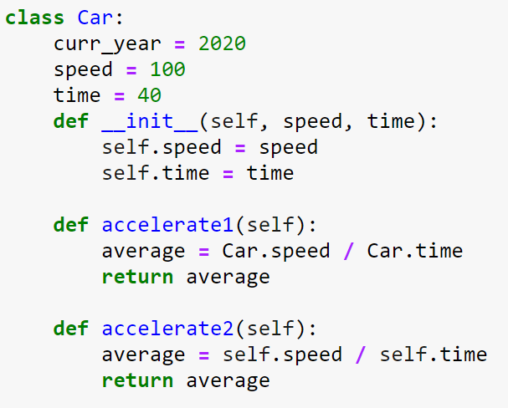
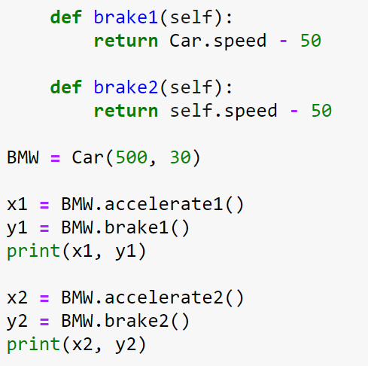
Class practice

Slide 30
Built-in class functions
Function | Description
getattr(obj,name,default) | used to access the attribute of the object.
setattr(obj, name,value) | used to set a particular value to the specific attribute of an object.
delattr(obj, name) | used to delete a specific attribute.
hasattr(obj, name) | returns true if the object contains some specific attribute.

Slide 31
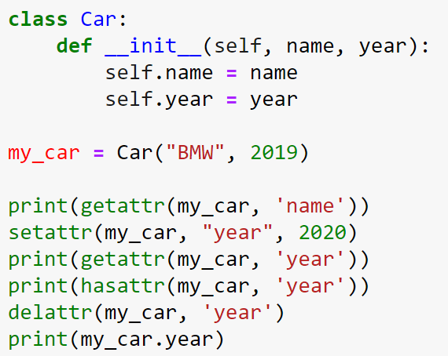
Built-in class attributes: example
Output:

Slide 32
built-in class attributes
Attribute | Description
__dict__ | provides the dictionary containing the information about the class namespace.
__doc__ | contains a string which has the class documentation (if defined)
__name__ | used to access the class name.
__module__ | used to access the module in which, this class is defined.
__bases__ | contains a tuple including all base classes.

Slide 33
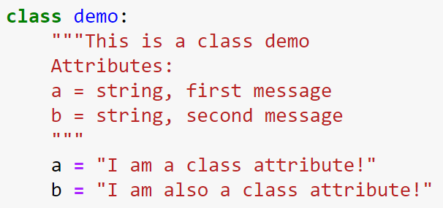

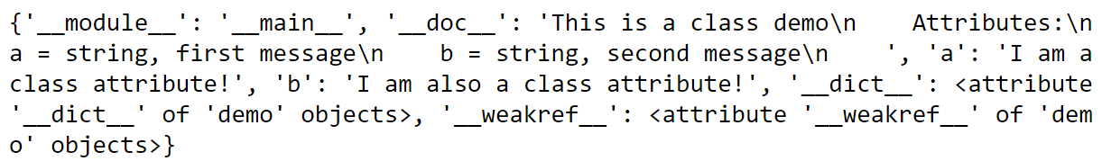
Built-in class attributes: __dict__
__dict__: A dictionary consisting of the classes namespace.

Slide 34

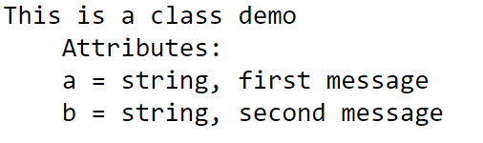
Built-in class attributes:__doc__
__doc__: class docstring (if defined).

Slide 35
invariants
invariant: An assertion that should be true of an object at all times (except perhaps while the object is being modified).
It is a useful programming practice that makes it easier to:
prove the correctness of code
check the integrity of data structures,
detect errors.

Slide 36
Invariants with an assert
A Python keyword that is followed by a Boolean expression and (optionally) a string.
If the Boolean expression is False, Python raises an exception with the provided string as a message.

Slide 37
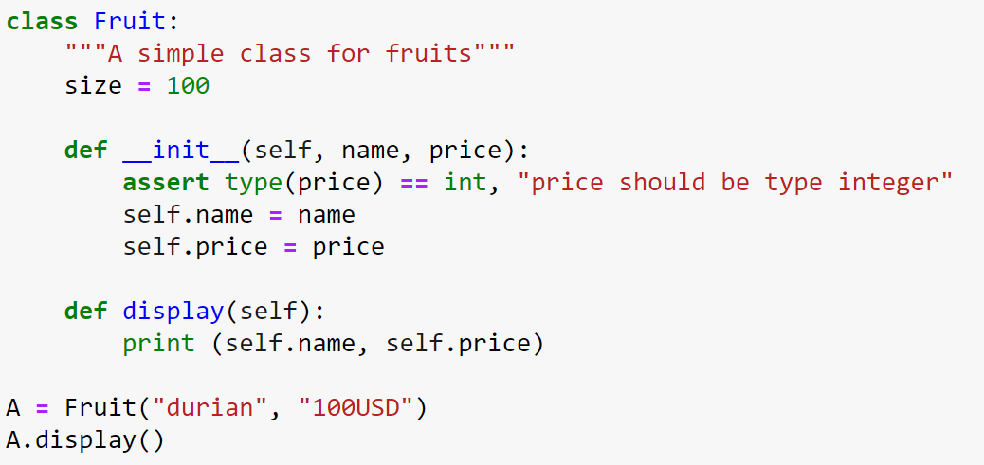
Checking invariants: example
String (optional)
keyword
Boolean expression
What is the program output?

